Slide 1
Support for Collaborative Feature Model Configuration
Li Yi
2011-10-28

Slide 2
About
The Work
Marcilio Mendonca, Donald Cowan (University of Waterloo, 2007 – 2008)
2007: Support for Collaborative Feature-Based Product Configuration in Software Product Lines (Technical Report)
2008: Decision-Making Coordination in Collaborative Product Configuration (SAC ‘08)
Relation to Our Work
Our work: Collaborative feature model construction
Support for configuration is one of the next steps

Slide 3
introduction

Slide 4


Background
Feature Model = Feature + Relationship
Construction: Make abstraction from a family of similar products in a specific domain
Configuration: Derive a product by selecting features without breaking the relationships
EXAMPLE: A Feature Model of Audio Playing Software Domain
Audio Playing Software
Optional
Mandatory
XOR-Group
Audio CD Codec
Burn CD
Platform
Requires
$$×$$
Excludes
$$×$$
Mobile
PC

Slide 5
FM Configuration often Involves Multi-Roles
Features span over several technical and non-technical knowledge
Decision makers with different backgrounds (e.g. customer, product manager, software engineer, database administrator)
The roles may also have a specific authority scheme: the decisions of a particular role (e.g. product manager or customer) should prevail over other roles’ decisions

Slide 6
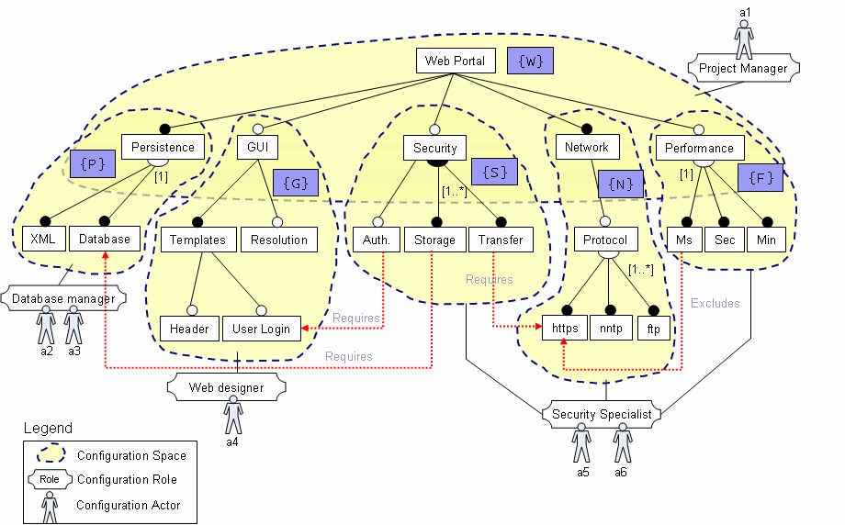
An Illustrative Example
{W}, {P}, {G}, {S}, {N}, {F}: Name of the Configuration Spaces
Constraints between Features

Slide 7

The Problem
In practice, FM configuration is a collaborative process
But no explicitly support for collaborative configuration
Numerous interactions required to resolve decision conflicts
Risk of requirements misinterpretations
As a consequence, effective tool support for collaborative configuration is missing.
Database Manager
Feature Model Configuration
Web Designer
Application Engineer
Security Specialist

Slide 8
The proposed approach

Slide 9
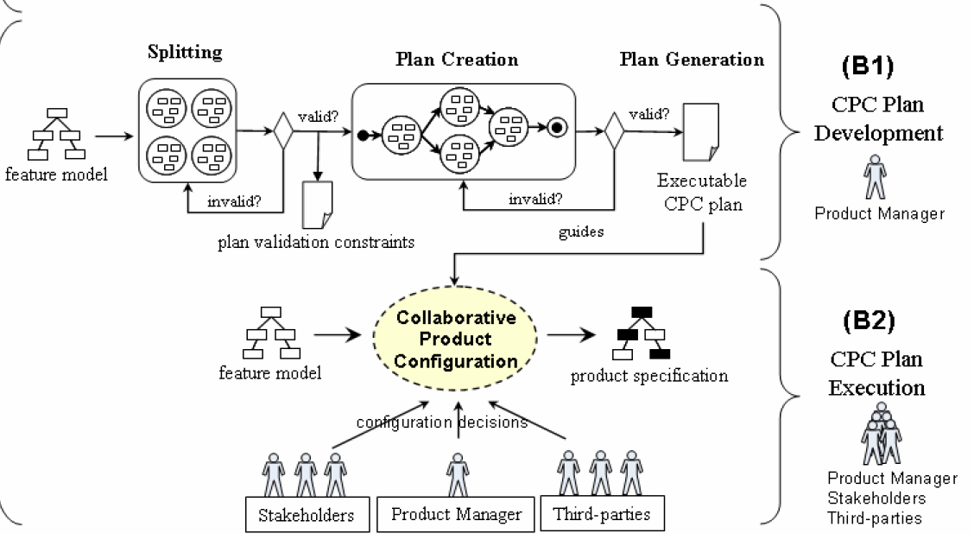
Overview

Slide 10
Split FM into Configuration Spaces
A configuration space (CS) is a subtree (of the whole feature tree)
Features in a feature group must belong to a single CS
Shared feature of 2 CS’s must follow the rule:
The feature is the root of a CS, and is a leaf of another
Role
*
*
Actor
1
*
CS

Slide 11
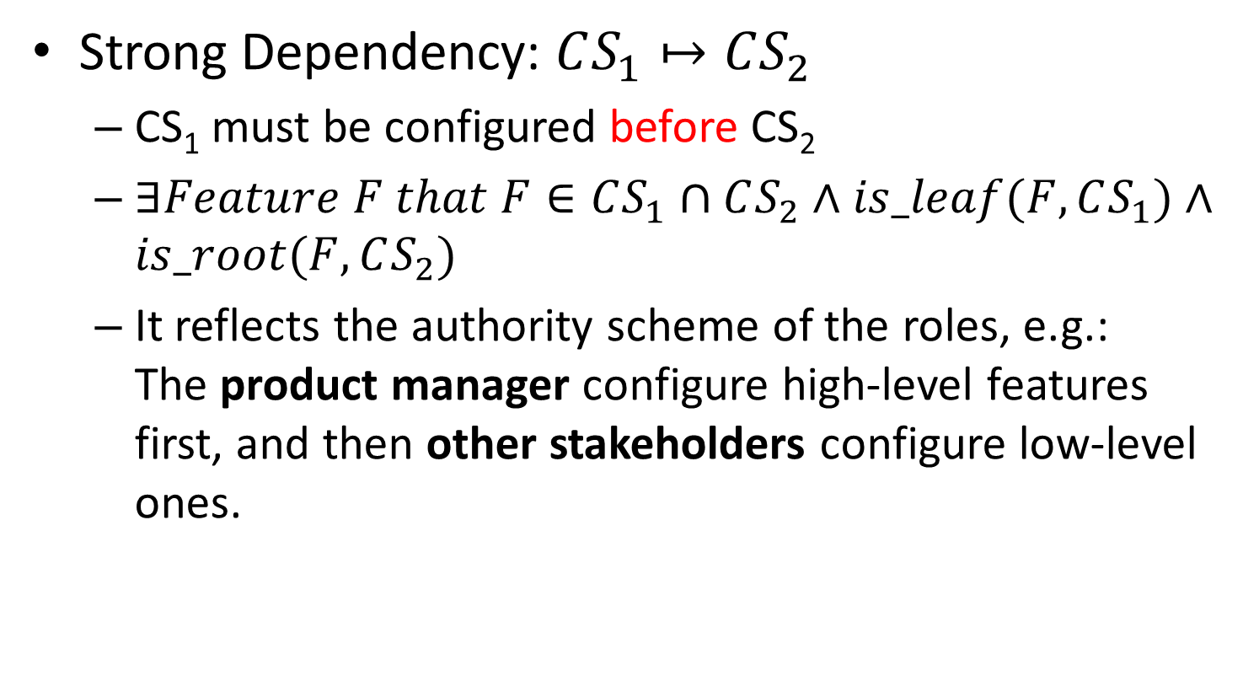
Dependency between CS’s
Strong Dependency: $CS_{1}↦CS_{2}$
CS₁ must be configured before CS₂
$∃Feature F that F∈CS_{1}∩CS_{2}∧is_leaf(F,CS_{1})∧is_root(F,CS_{2})$
It reflects the authority scheme of the roles, e.g.: The product manager configure high-level features first, and then other stakeholders configure low-level ones.

Slide 12
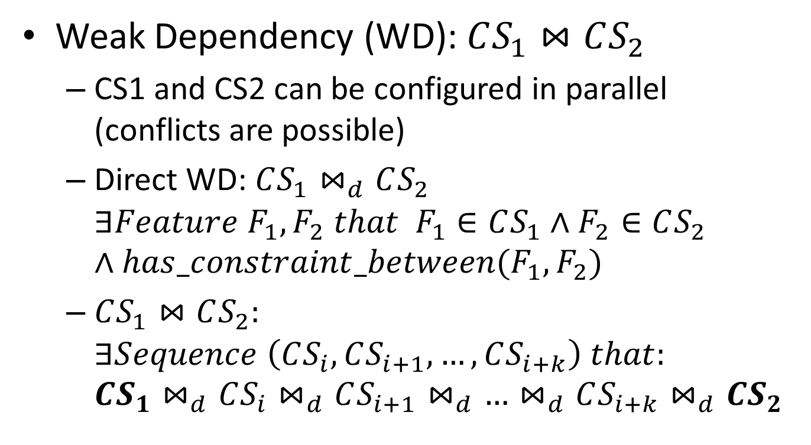
Dependency between CS’s (cont.)
Weak Dependency (WD): $CS_{1}⋈CS_{2}$
CS1 and CS2 can be configured in parallel (conflicts are possible)
Direct WD: $CS_{1}⋈_{d}CS_{2}$ $∃Feature F_{1},F_{2} that F_{1}∈CS_{1}∧F_{2}∈CS_{2}$ $∧has_constraint_between(F_{1},F_{2})$
$CS_{1}⋈CS_{2}:$ $∃Sequence \left(CS_{i},CS_{i+1},…,CS_{i+k}\right) that:$ $CS_{1}⋈_{d}CS_{i}⋈_{d}CS_{i+1}⋈_{d}…⋈_{d}CS_{i+k}⋈_{d}CS_{2}$

Slide 13

Configuration Plan
Planning a workflow of CS’s, following 3 rules:
If $CS_{1}↦CS_{2}$, then CS₁ must precede CS₂
If $CS_{1}⋈CS_{2}$, then CS1 and CS2 are done either
Sequentially, or
In parallel but immediately followed by a merging task
Conflict-Free
Conflict-Free
Conflict-Prone
{W}
CS Dependency Graph
{P}
{S}
{G}
Strong
{N}
{F}
Weak

Slide 14
Configuration Plan
Planning a workflow of CS’s, following 3 rules:
If $CS_{1}↦CS_{2}$, then CS₁ must precede CS₂
If $CS_{1}⋈CS_{2}$, then CS1 and CS2 are done either
Sequentially, or
In parallel but immediately followed by a merging task
{W}
{S}
{W}
Planning
{P}
{G}
{N}
{F}
{P}
{S}
{G}
{N}
{F}
Merge

Slide 15
Merge Configurations
Configuration = { op | op is a bind/remove operation on a feature }
2 Merge Methods
Priority_Merge(C1, C2, C1 > C2): When conflict happens, keep operations in C1
Min_Change_Merge(C1, C2): Make minimal changes on existing bind/remove operations

Slide 16
An example

Slide 17
The FM, CS’s, and Plan
{W}
{S}
{P}
{G}
{N}
{F}
Merge

Slide 18
1. Product Manager
INPUT
Web Portal
cv
GUI
Security
cv
Persistence
Network
Performance
COMMIT
{
Web Portal, Persistence, GUI, Security, Network, Performance,
Templates // Mandatory child of GUI
}

Slide 19
2.1 Security Specialist (3 CS’s)
INPUT
CS₁
Security
OR
Authentication
Storage
Transfer
requires
requires
requires
Network
CS₂
Performance
CS₃
OR
XOR
https
nntp
ftp
ms
second
minute
excludes
COMMIT
1. { Security, Authentication, User Login, Storage, Database, ~ XML, ~ Transfer }
2. { Network, ~ https, nttp, ftp }
3. { Performance, ms, ~ second, ~ minute }

Slide 20
2.2 Web Designer
INPUT
COMMIT
GUI
{ GUI, Templates, Resolution, Header,
~ User Login, ~Authentication }
cv
Resolution
Templates
requires
Header
User Login
2.3 Database Manager
INPUT
COMMIT
Persistence
XOR
{ Persistence, XML, ~Database }
XML
Database

Slide 21
Merge 1: Priority_Merge
Conflicts
Security Specialist: { Security, Authentication, User Login, Storage, Database, ~XML, ~Transfer }
Web Designer: { GUI, Templates, Resolution, Header, ~User Login, ~Authentication }
Resolve: Security Specialist > Web Designer
{ ..., Authentication, User Login, … }

Slide 22
Merge 2: Min_Change_Merge
Conflicts
Security Specialist: { Security, Authentication, User Login, Storage, Database, ~XML, ~Transfer }
Database Manager: { Persistence, ~Database, XML }
Resolve
Attempt #1: Keep { Database }, change 1 operation: { XML } ➔ { ~ XML } (Database Manager)
Attempt #2: Keep { XML }, change 5 operations: { Storage, ~Transfer, ~https, ms, ~second}➔{ ~Storage, Transfer, https, ~ms, second} (Security Specialist)
Conclusion: Keep { Database }

Slide 23
summary

Slide 24
Summary
A two-staged, role-based, controlled collaboration
A work unit is a feature sub-tree
Planning is based on dependencies between work units
Possible Improvements
Planning Strategy

Slide 25
Planning Strategy
观察前述例子，我们发现{S} (Security Specialist) 是依赖图中的一个关键点（度数最大）。假设把S安排在其他决策之前做，那么：
将不存在例子中出现的两个冲突，从而使得关键的Security需求最大程度得到满足（因为解决冲突有可能会改变{S}中的决策）
按照依赖图的结构来安排子任务的顺序，使得：
关键的任务尽可能先做（从而关键的需求得以满足）
尽可能降低冲突发生的机会
{W}
{S}
{W}
Planning
{P}
{G}
{N}
{F}
{P}
{S}
{G}
{N}
{F}
Merge

